Slide 1
Iteris 511 Traffic & Transit Mobile App
December 4, 2018

Slide 2
Iteris Transportation Systems
State and Federal Government
Local Agencies
Traveling Public
Guiding the policy development for intelligent transportation and technology solutions that bridge the gap in our communities to the future of transport
Providing comprehensive advisory, design and operations services to build thriving communities
Delivering predictive and prescriptive actionable transportation information that result in safer and more efficient travel
Notes:
First and foremost, we are a transportation technology firm – we have been delivering forward looking solutions for ITS and technology supporting State, Federal, and local agencies for over 20 years in all 50 states. We support and help to build thriving communities. We consider our ultimate client the travelling public to whom we deliver predictive, prescriptive and actionable transportation information that results in safety and more efficient mobility. Iteris is very unique in our space because we bring deep and proven experience in the entire transportation life cycle: Planning, Design, Integration, Operations and Maintenance.

Slide 3
L.A. Metro Orange Line
Bus Rapid Transit Corridor – Crossing Gates
Corridor to operate buses akin to trains
Utilize multiple vehicular detection zones to activate railroad gates
Develop Preemption Timing at the crossing
Connected Bus
Receive continuous data from the LA traffic system
Predict start of green for the bus corridor
Use prediction to estimate ideal speed for the bus to maintain smooth flow
Utilize connected vehicle technology to display ideal speed to driver

Slide 4
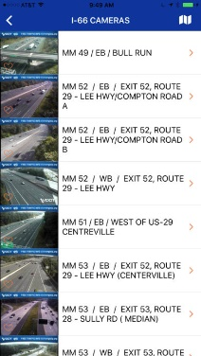
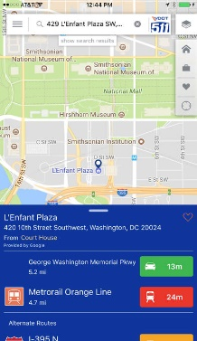
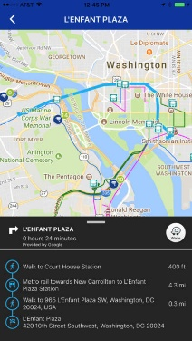
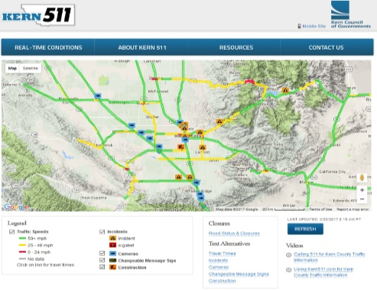
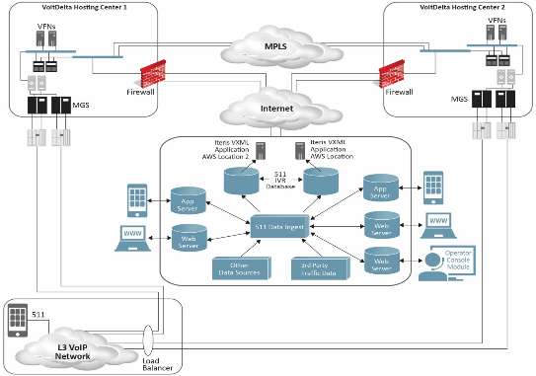
Traveler Information Product Portfolio
Mobile App
Web
IVR
One-stop-shop featuring all transportation modes
Real-time multimodal information with CCTV streaming
Comprehensive cloud-based travel information

Slide 5
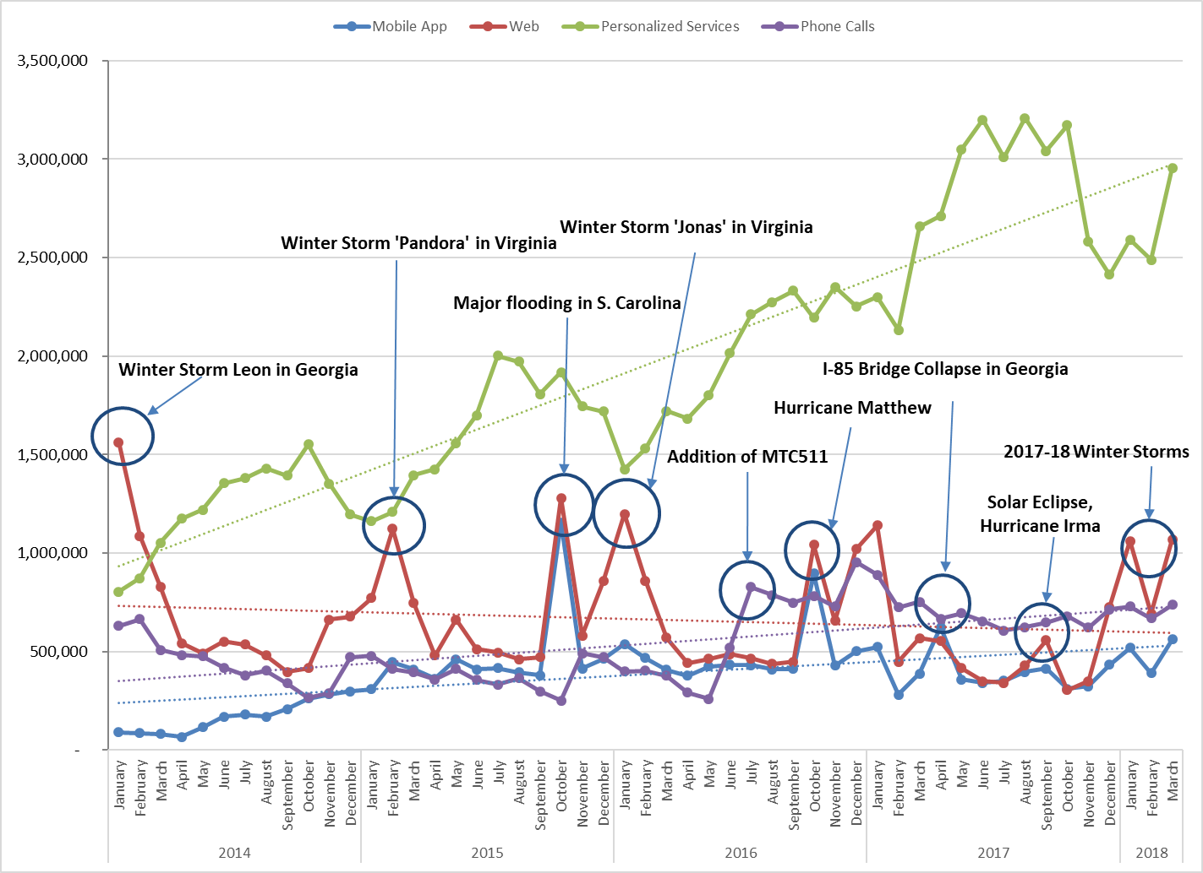
Monthly Touches – Event Driven

Slide 6
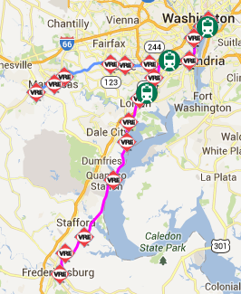
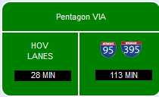
Mobile App – Moving solo drivers to HOV and Transit
Primary mission (defined by our customers) is traffic information
By strategically providing actionable HOV and transit information we support TDM by targeting SOV drivers with viable options

Slide 7
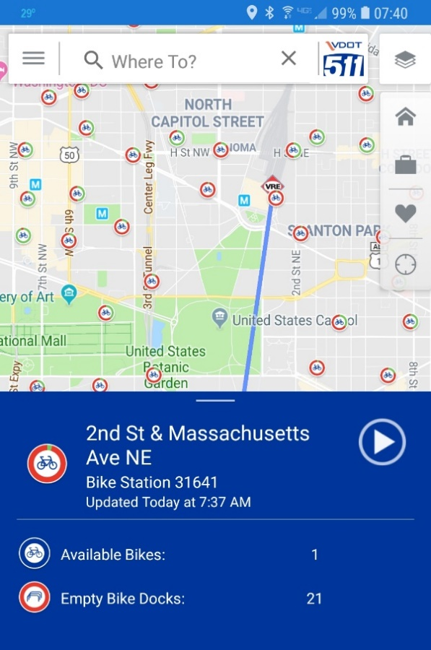
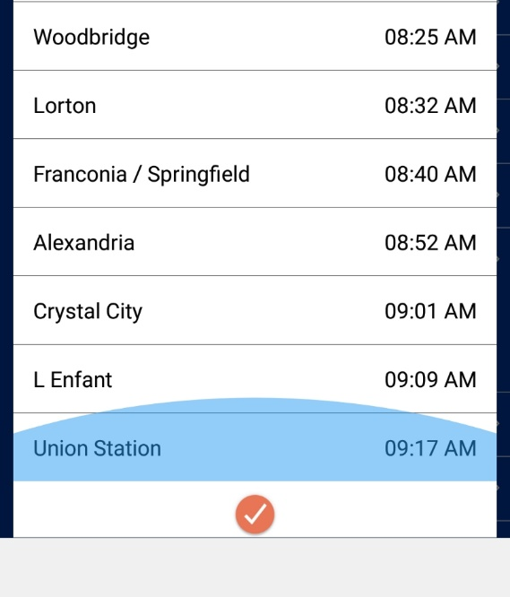
Actionable Transit Information

Slide 8
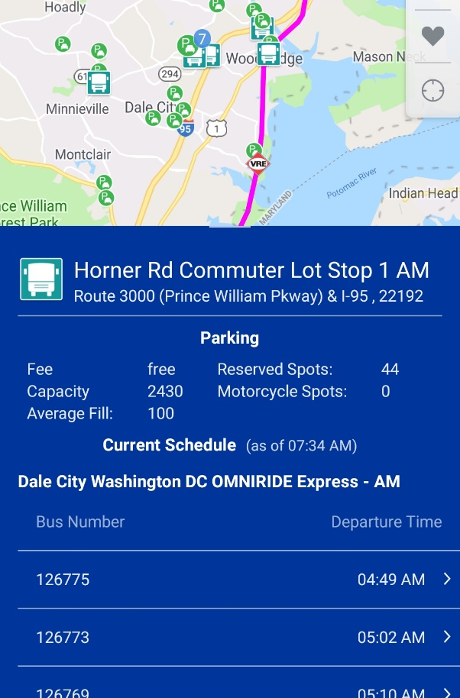
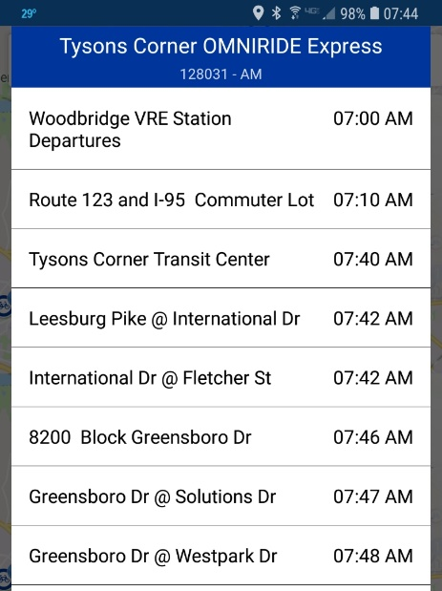
Can I Park & Ride today?

Slide 9
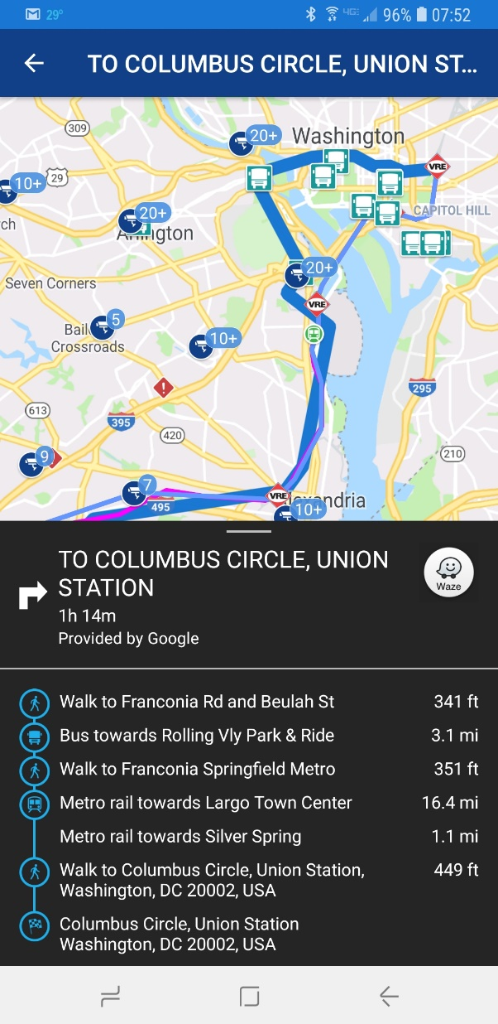
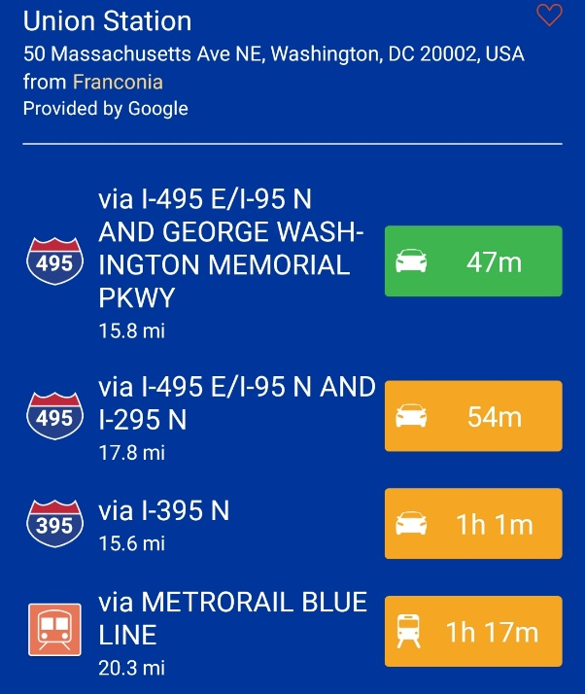
Traditional “Multi-Modal” Directions

Slide 10
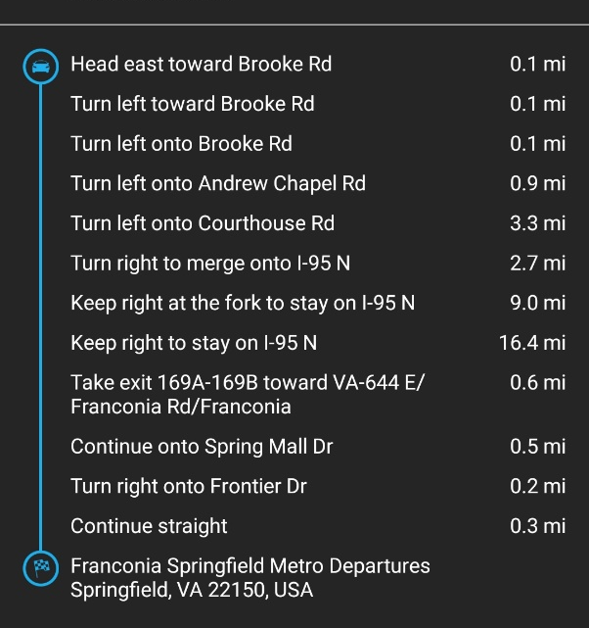
True Multi-Modal Directions

Slide 11
Thank You!
Steve Gaddy
sgaddy@iteris.com

